Slide 1
FIN 335 FINAL PROJECT
Samuel Andrews

Slide 2
Non-seasonal Time Series: Global Price of Tin (1980 – 2016)

Slide 3
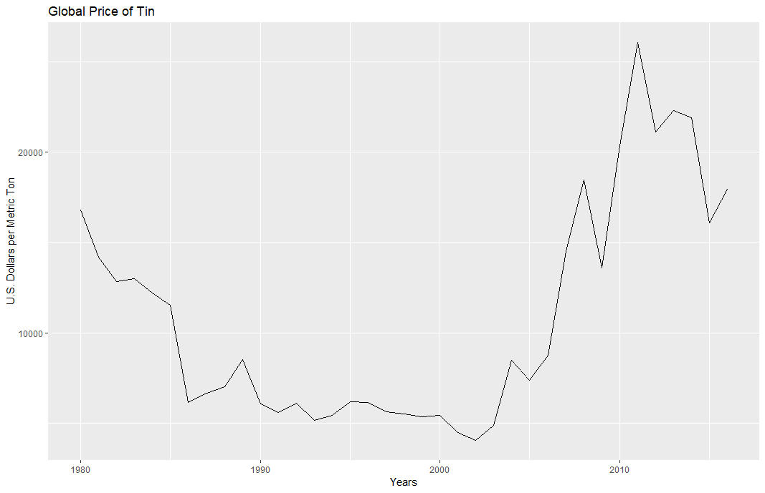
The Series
Annual Data
Plastic Trend
Economic
Raw Material

Slide 4
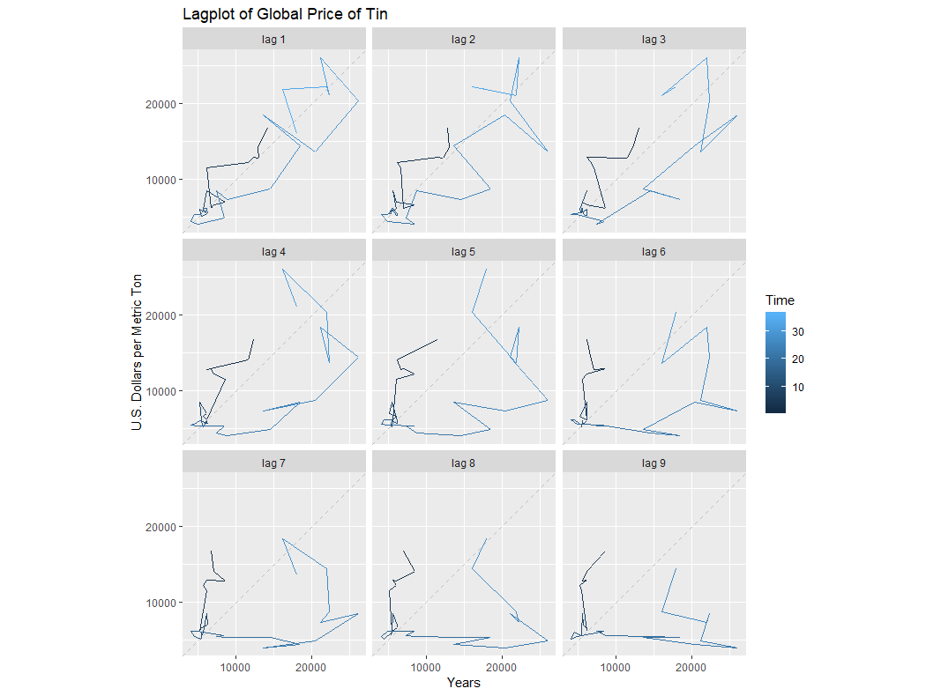
Lag Plot
Early Trend
Autocorrelation
Both break down

Slide 5
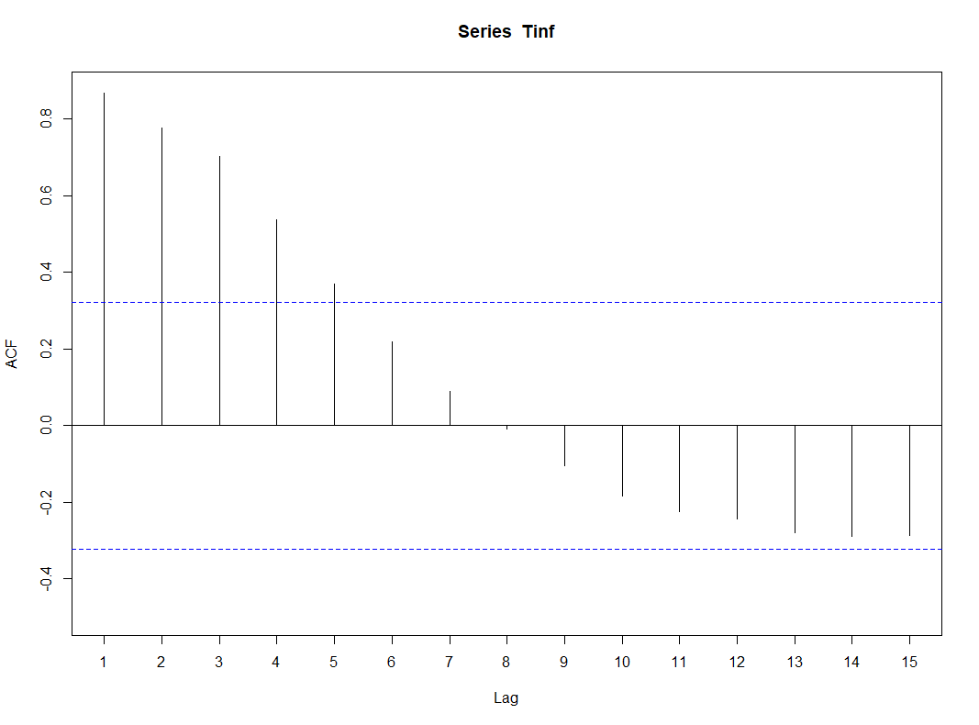
Acf Plot
Autocorrelation
Tapers off quickly

Slide 6
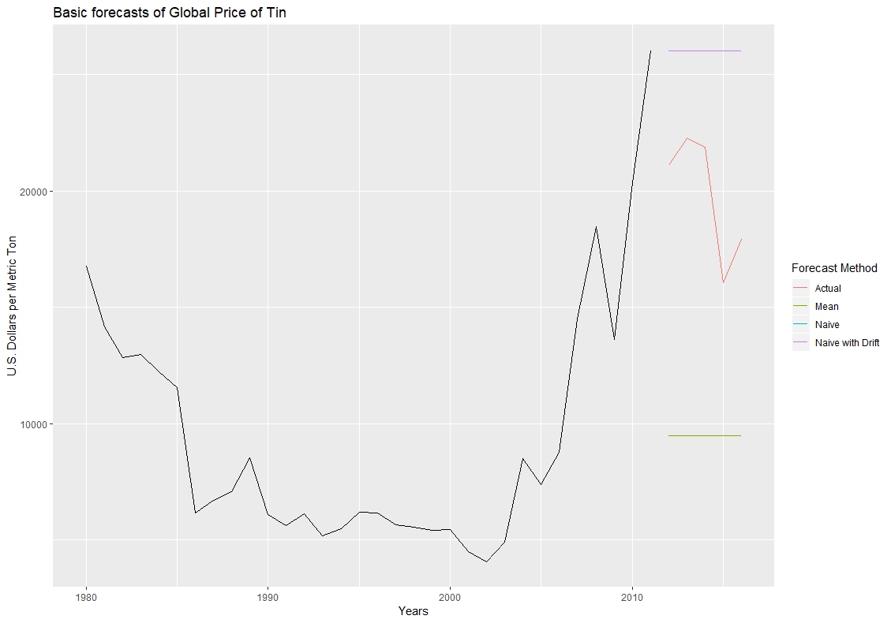
Basic Forecasts
Unhelpful
Expected

Slide 7
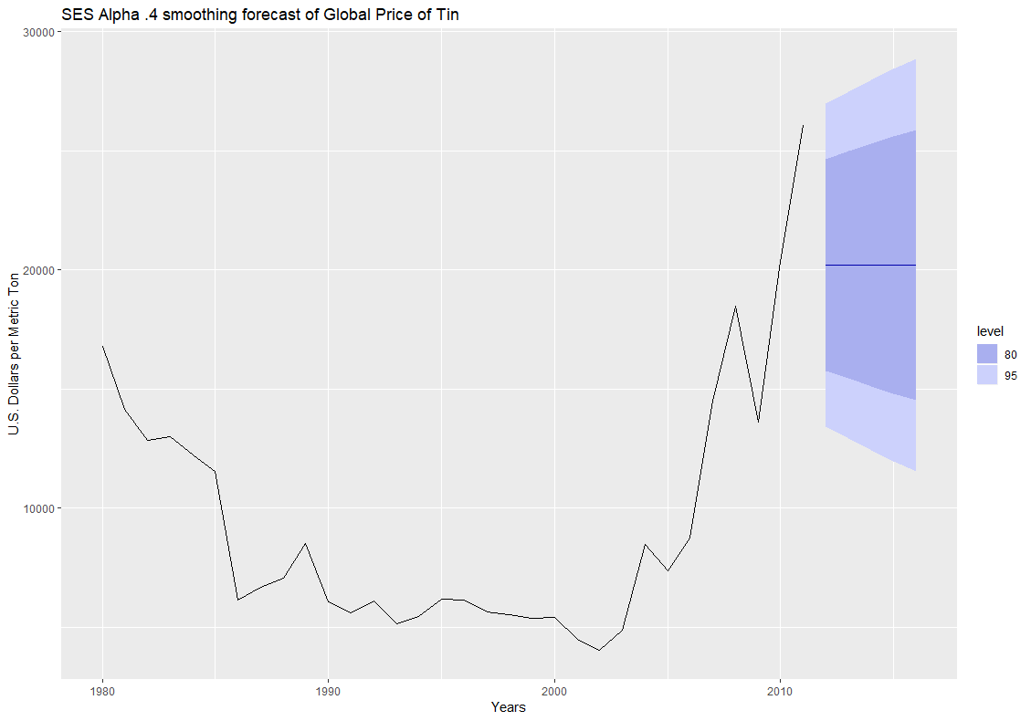
Simple Exp. Smoothing
Alpha = 0.4
RMSE = 246.314
MAE = -3.389
MAPE = 11.954

Slide 8
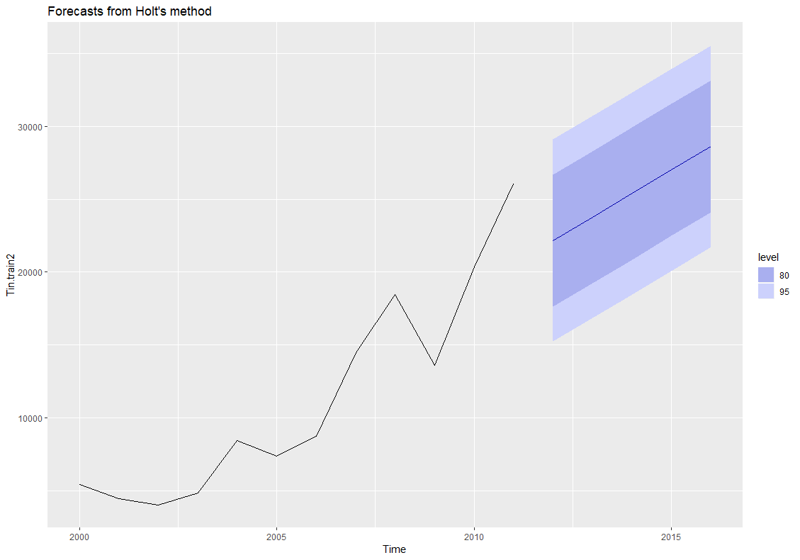
Holt’s Linear
Undamped
Truncated Training
RMSE = 7064.103
MAE = 5535.136
MAPE = 31.0739

Slide 9
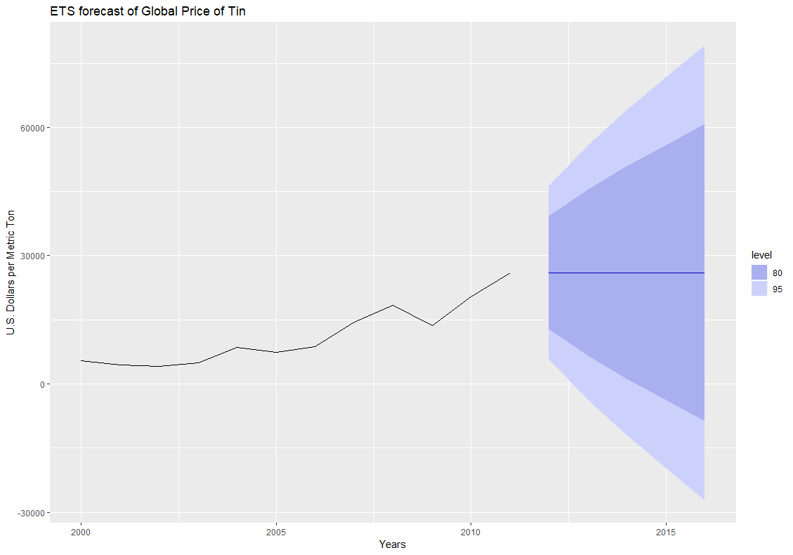
ETS
Truncated Training
RMSE = 6645.897
MAE = 6192.136
MAPE = 33.338

Slide 10
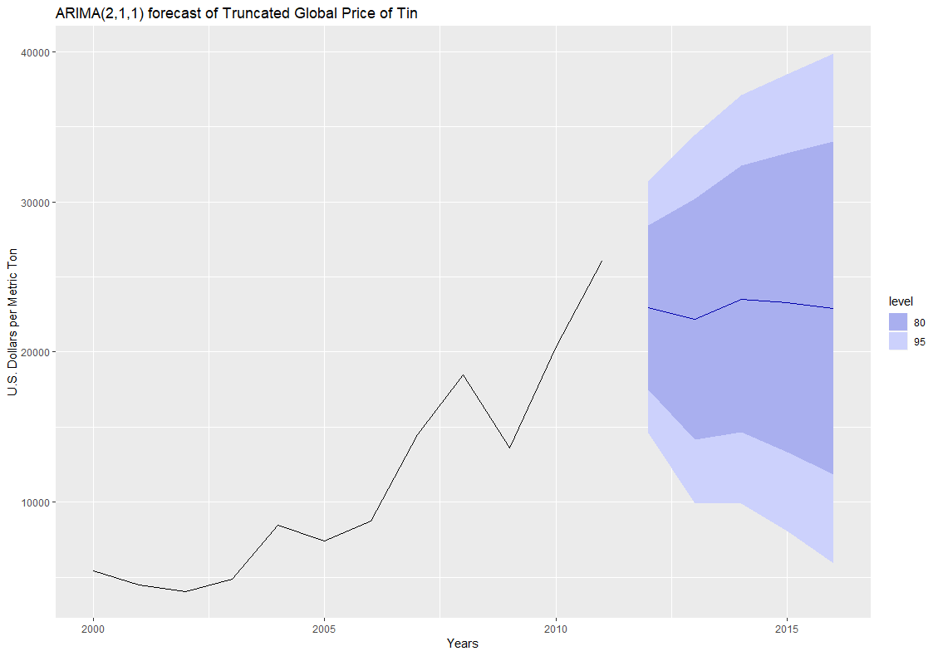
Box Jenkins ARIMA
Truncated Training
ARIMA(2,1,1)
RMSE = 4083.392
MAE = 3164.404
MAPE = 17.917

Slide 11
Results
Model | RMSE ($/Metric Ton) | MAE ($/Metric Ton) | MAPE (%)
Mean | 10677.600 | 10395.901 | 51.561
SES Alpha = 0.4 | 246.314 | -3.389 | 11.954
Holt’s Linear | 7064.103 | 5535.136 | 31.0739
ETS | 6645.897 | 6192.136 | 33.338
ARIMA – (2,1,1) | 4083.392 | 3164.404 | 3164.404

Slide 12
Seasonal Time Series: Total Vehicle Sales (3/09 – 3/19)

Slide 13
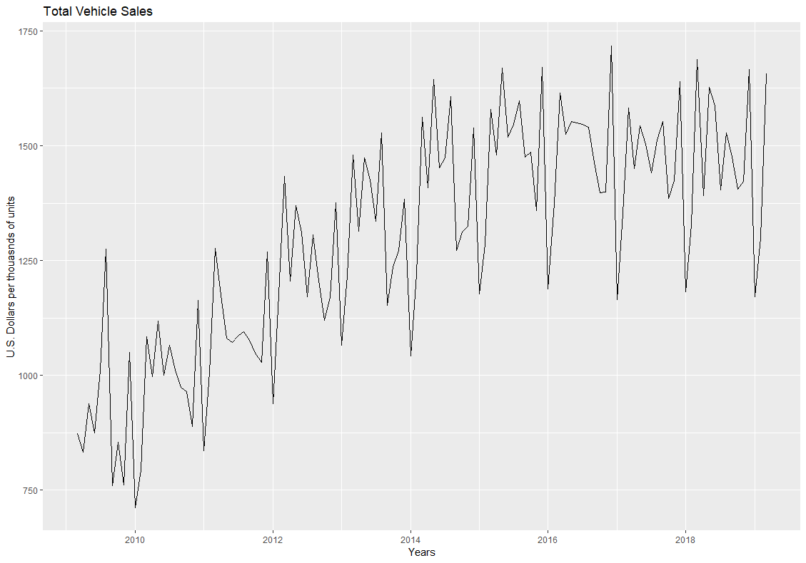
The Series
Monthly Data
Positive Trend
Seasonal
Economic

Slide 14
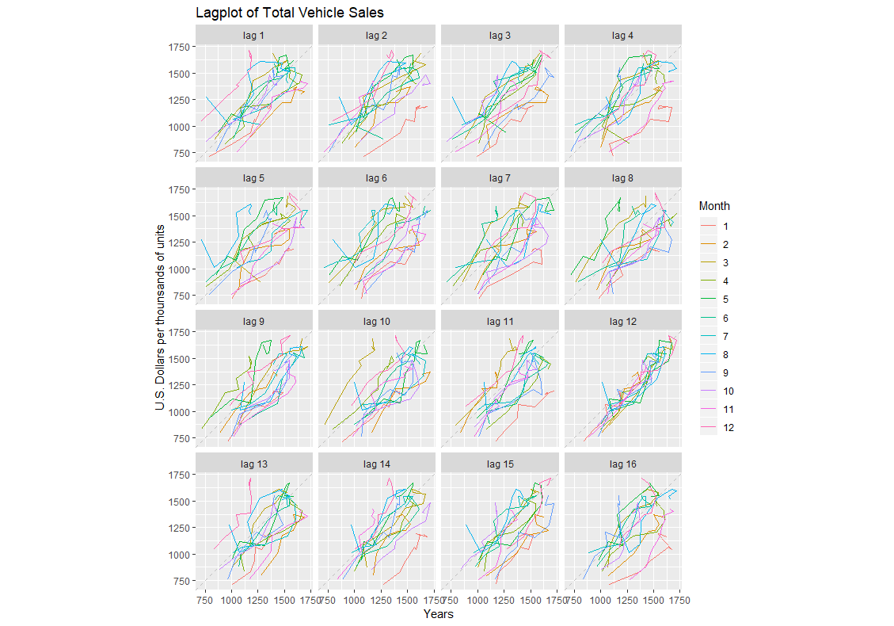
Lag Plot
Weaker autocorrelation throughout
Begins to break away towards the end

Slide 15
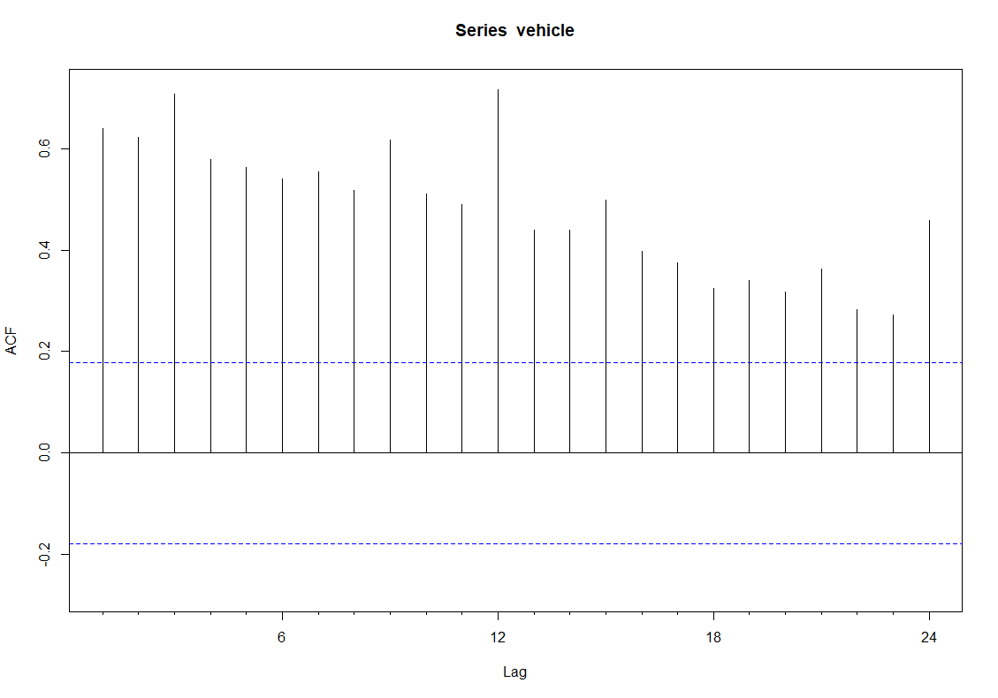
Acf Plot
Significant Autocorrelation

Slide 16
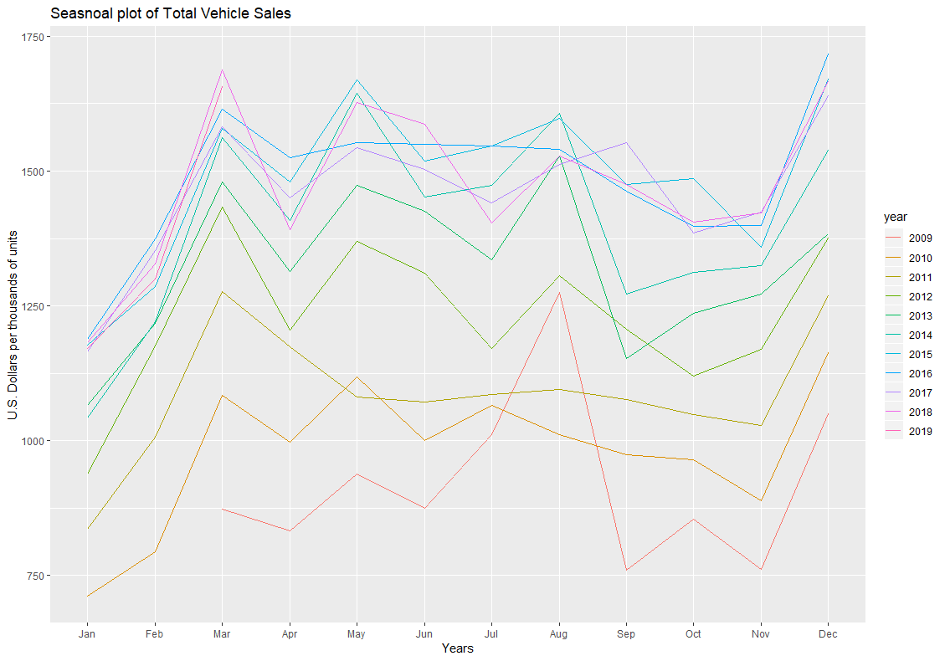
Season Plot
Very awkward but consistent trends
Makes the sense given the nature of the fishing industry

Slide 17
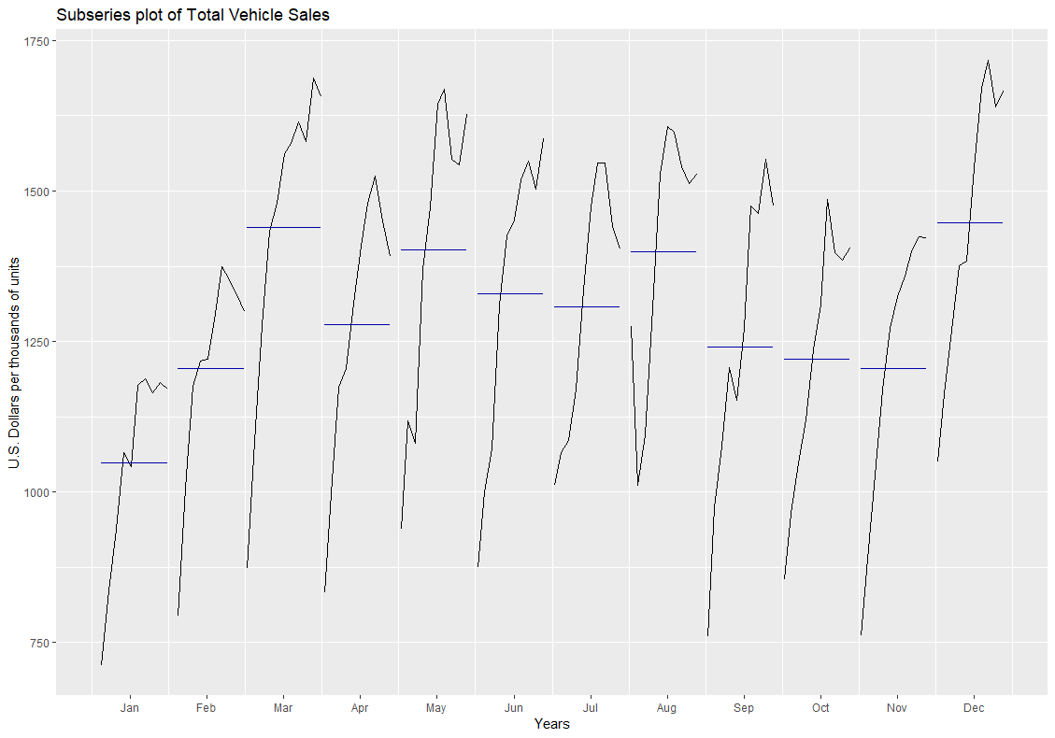
Subseries Plot
Peaks in March, Decembers, and May
Troughs in January and November

Slide 18
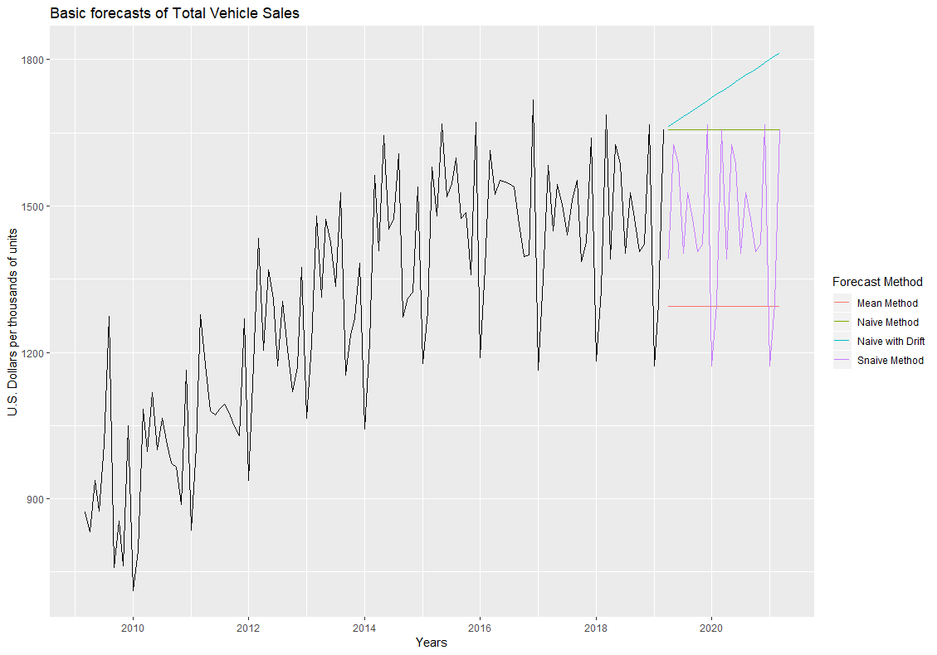
Basic Forecasts
Slightly more useful
Seasonal Naïve is especially useful

Slide 19
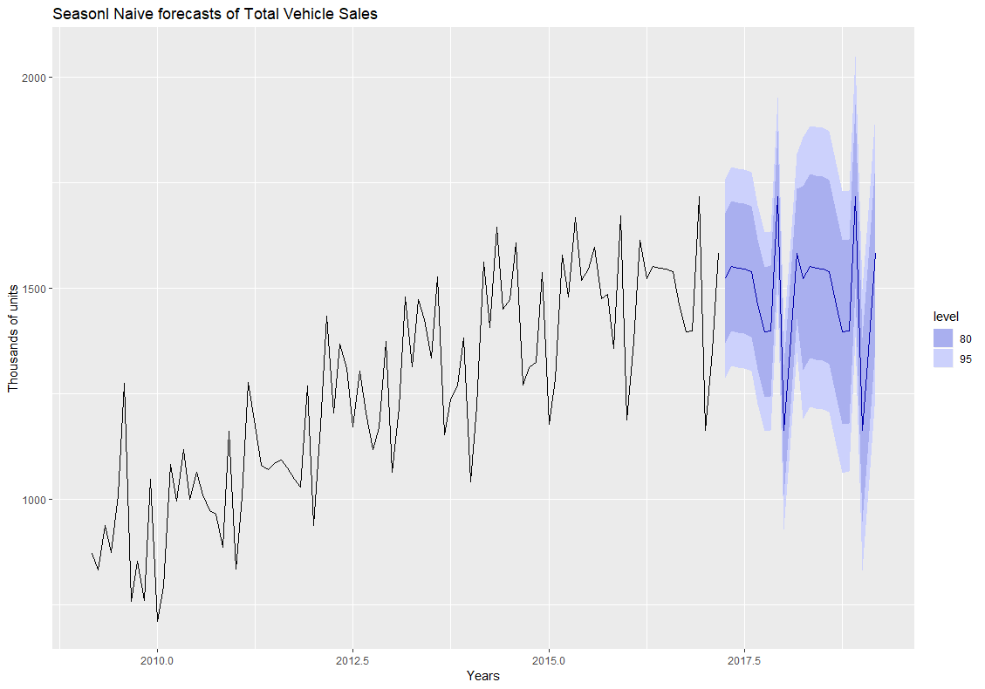
Seasonal Naive
Truncated
RMSE = 65.767
MAE = 51.886
MAPE = 3.478

Slide 20
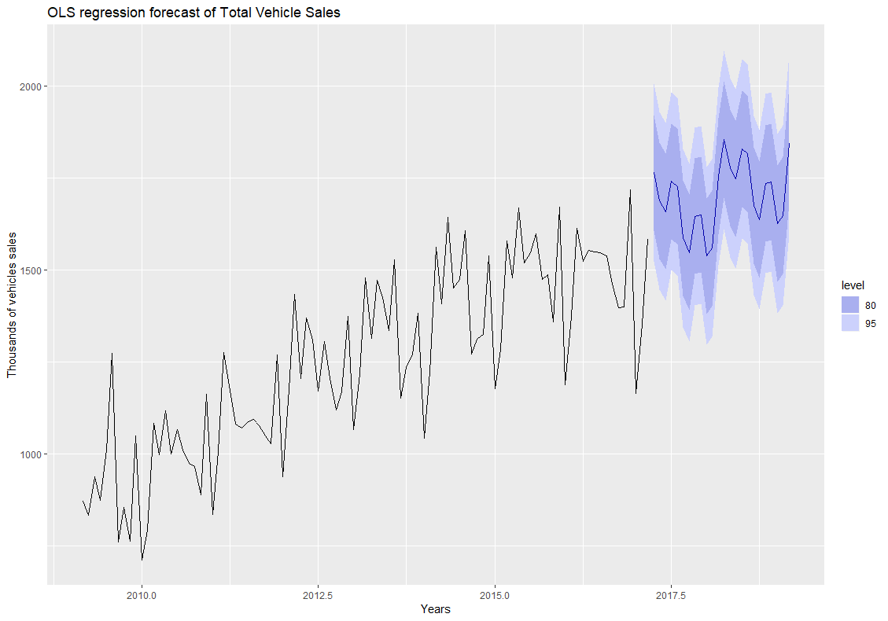
OLS Regression
Truncated
RMSE = 128.786
MAE = 103.875
MAPE = 7.332

Slide 21
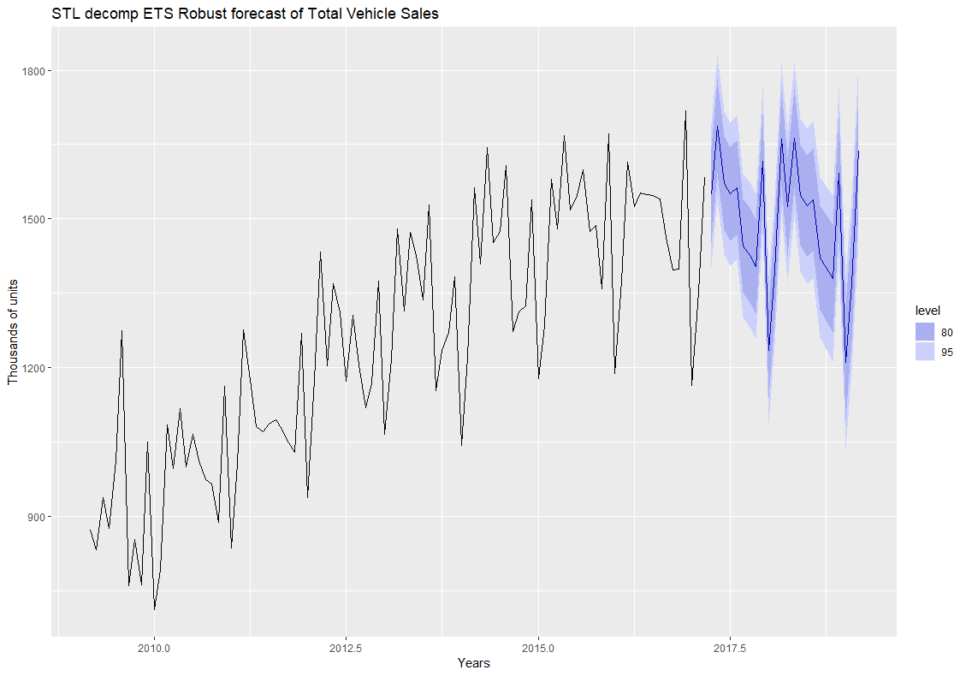
STL Decomposition
Truncated
RMSE = 73.363
MAE = 58.954
MAPE = 3.961

Slide 22
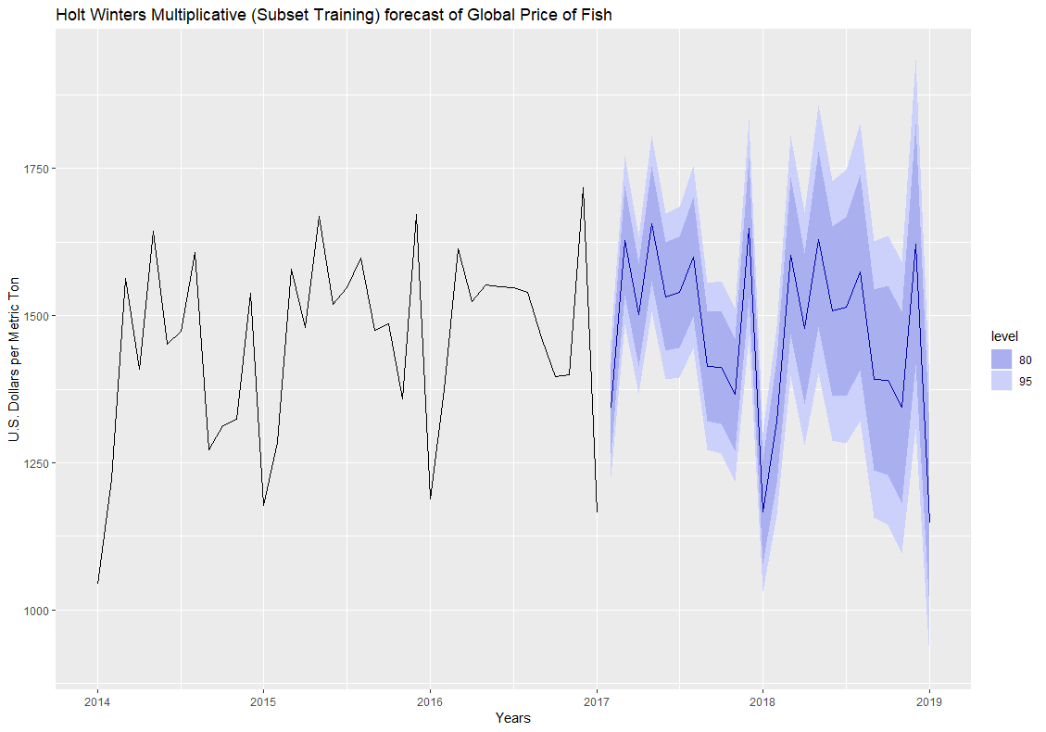
Holt Winters
Truncated
RMSE = 70.491
MAE = 58.911
MAPE = 3.974

Slide 23
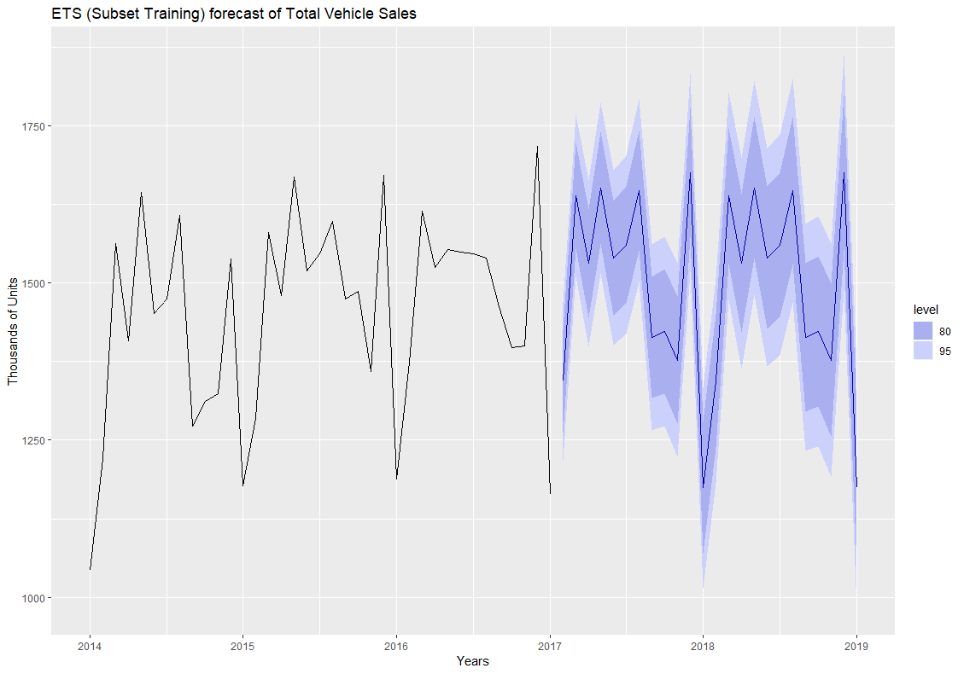
ETS
Truncated
RMSE = 81.653
MAE = 65.307
MAPE = 4.412

Slide 24
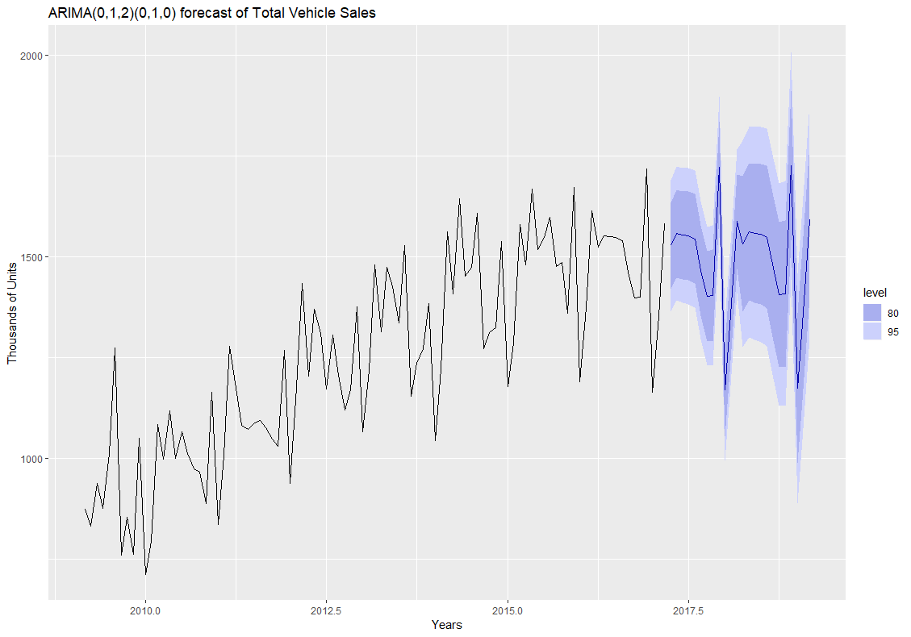
ARIMA(0,1,2)(0,1,0)
Truncated
RMSE = 67.133
MAE = 51.879
MAPE = 3.479

Slide 25
Results
Model | RMSE ($/Metric Ton) | MAE ($/Metric Ton) | MAPE (%)
Mean | 258.422 | 231.184 | 15.144
Seasonal Naïve | 65.767 | 51.886 | 3.478
OLS Regression | 128.786 | 103.875 | 7.332
STL Decomposition (ETS, Robust) | 73.363 | 58.954 | 3.961
Holt Winters | 70.491 | 58.911 | 3.974
ETS | 81.653 | 65.307 | 4.412
ARIMA(0,1,2)(0,10) | 67.133 | 51.879 | 3.479

Slide 26
Links to Time Series
https://fred.stlouisfed.org/series/PTINUSDA
https://fred.stlouisfed.org/series/TOTALNSA

